Slide 1
Counters
Part 1

Slide 2
Counters
What is a counter?
Asynchronous Counter
Up Counter
Down Counter
Synchronous Counter
Arbitrary Counter

Slide 3
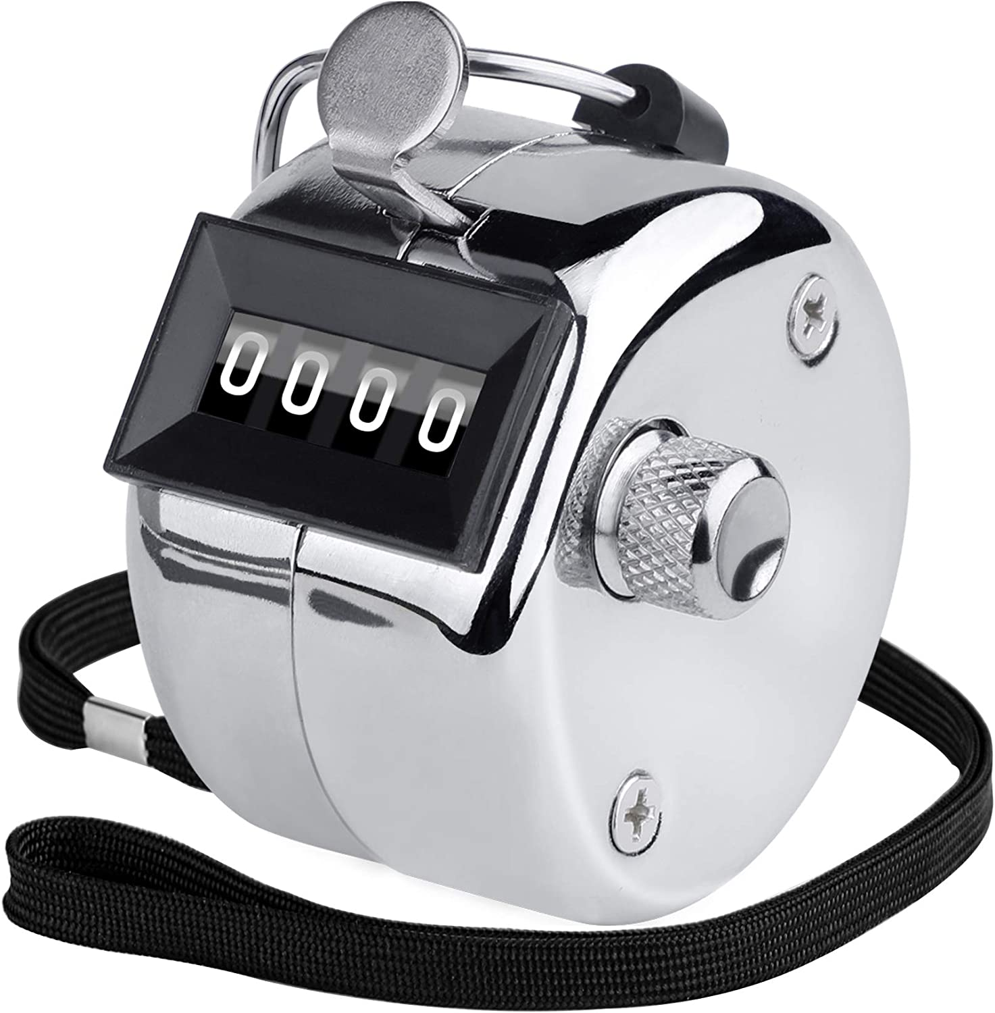
What is a counter?

Slide 4
Counters
Counters are sequential circuits which "count" through a specific state sequence. They can count up, count down, or count through other fixed sequences. Two distinct types are in common usage:
Ripple Counters
Clock is connected to the flip-flop clock input on the LSB bit flip-flop
For all other bits, a flip-flop output is connected to the clock input, thus circuit is not truly synchronous
Output change is delayed more for each bit toward the MSB.
Resurgent because of low power consumption
Synchronous Counters
Clock is directly connected to the flip-flop clock inputs
Logic is used to implement the desired state sequencing

Slide 5
Ripple Counter (continued)
These circuits are called ripple counters because each edge sensitive transition (positive in the example) causes a change in the next flip-flop’s state.
The changes “ripple” upward through the chain of flip-flops, i. e., each transition occurs after a clock-to-output delay from the stage before.

Slide 6
ASYNCHRONOUS COUNTERS
A.K.A Ripple Counter

Slide 7
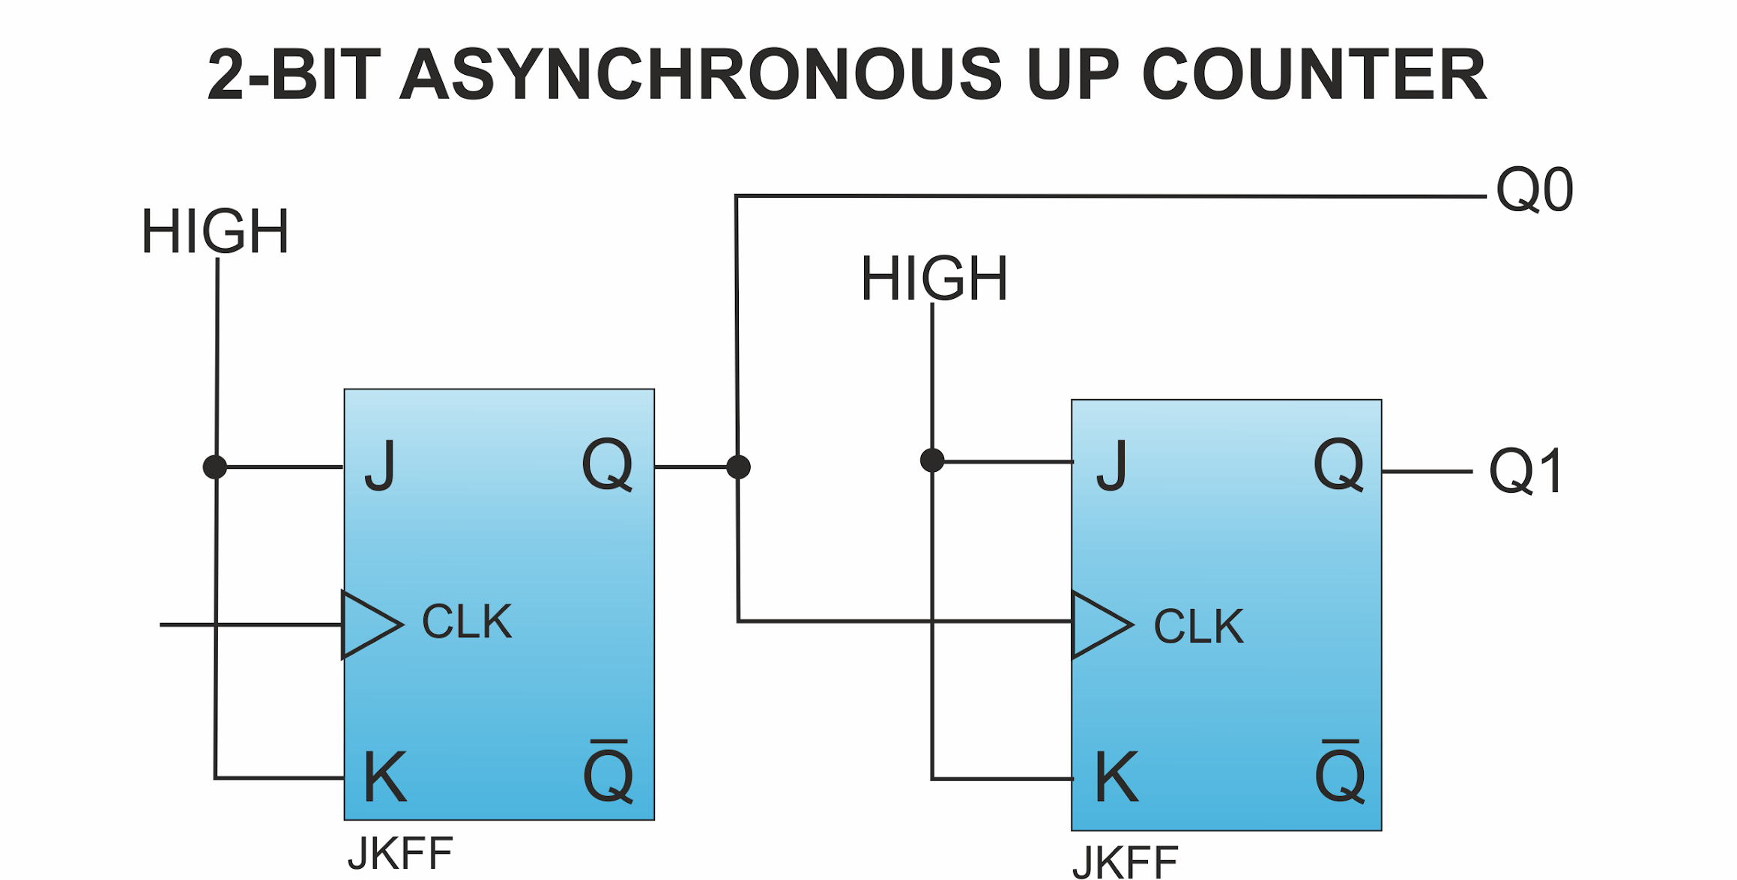
Asynchronous Counter
An asynchronous 2 bit counter using negative edge triggered JK flip flop

Slide 8
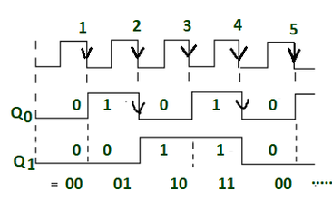

Asynchronous Counter
An asynchronous 2 bit counter using negative edge triggered JK flip flop

Slide 9
Asynchronous Counter
An asynchronous 2 bit counter using negative edge triggered JK flip flop
0
0

Slide 10
Asynchronous Counter
An asynchronous 2 bit counter using negative edge triggered JK flip flop
1
0

Slide 11
Asynchronous Counter
An asynchronous 2 bit counter using negative edge triggered JK flip flop
0
1

Slide 12
Asynchronous Counter
An asynchronous 2 bit counter using negative edge triggered JK flip flop
1
1

Slide 13
Asynchronous Counter
An asynchronous 2 bit counter using negative edge triggered JK flip flop
0
0

Slide 14
Asynchronous Counter
An asynchronous 2 bit up counter using negative edge triggered JK flip flop
LSB
0
0
MSB

Slide 15
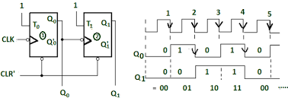
Asynchronous Counter
An asynchronous 2 bit up counter using negative edge triggered T flip flop

Slide 16
Asynchronous Counter
An asynchronous up counter using negative edge triggered T flip flop
Difference?
Previously we used J=1 and K=1 for toggling.
Here we are using T=1

Slide 17
Asynchronous Counter
Can we use any type of flip flop for designing asynchronous counters ?
Yes
As we know about flip flop conversion
We can convert any flip flop to JK or T
This is applicable for up, down and up/down counters

Slide 18
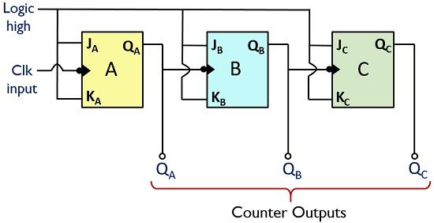
Asynchronous Counter
An asynchronous 3 bit up counter using negative edge triggered JK flip flops

Slide 19
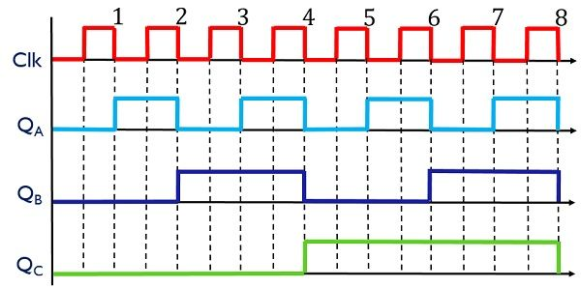
Asynchronous Counter
An asynchronous 3 bit up counter using negative edge triggered JK flip flops
0
0
0
QcQbQa
0 0 0

Slide 20
Asynchronous Counter
An asynchronous 3 bit up counter using negative edge triggered JK flip flops
1
0
0
QcQbQa
0 0 1

Slide 21
Asynchronous Counter
An asynchronous 3 bit up counter using negative edge triggered JK flip flops
0
1
0
QcQbQa
0 1 0

Slide 22
Asynchronous Counter
An asynchronous 3 bit up counter using negative edge triggered JK flip flops
1
1
0
QcQbQa
0 1 1

Slide 23
Asynchronous Counter
An asynchronous 3 bit up counter using negative edge triggered JK flip flops
0
0
1
QcQbQa
1 0 0

Slide 24
Asynchronous Counter
An asynchronous 3 bit up counter using negative edge triggered JK flip flops
1
0
1
QcQbQa
1 0 1

Slide 25
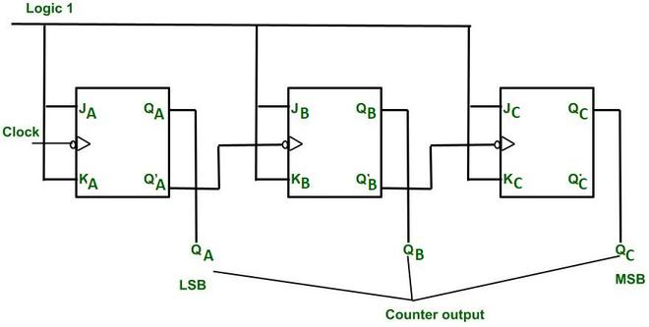
Asynchronous Counter
An asynchronous 3 bit down counter using negative edge triggered JK flip flops

Slide 26
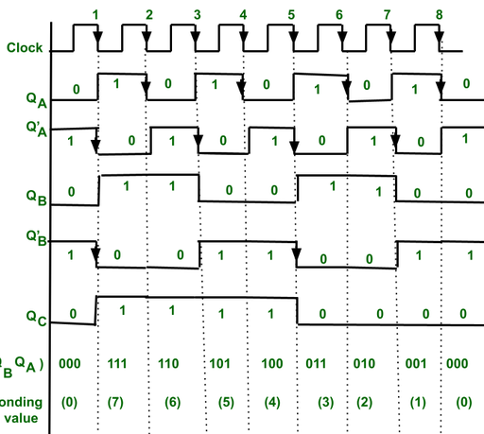
Asynchronous Counter
An asynchronous 3 bit down counter using negative edge triggered JK flip flops
1
1
0
0
0

Slide 27
Asynchronous Counter
An asynchronous 3 bit down counter using negative edge triggered JK flip flops
0
0
1
1
1

Slide 28
Asynchronous Counter
An asynchronous 3 bit down counter using negative edge triggered JK flip flops
0
0
1
1
0

Slide 29
Asynchronous Counter
An asynchronous 3 bit down counter using negative edge triggered JK flip flops
0
1
1
0
1

Slide 30
SYNCHRONOUS COUNTER

Slide 31
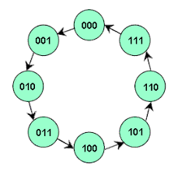
Synchronous Counter
We are again back to the usual sequential circuit design !
Let us make a 3 bit synchronous up counter
Notice that
there are no
inputs/outputs

Slide 32
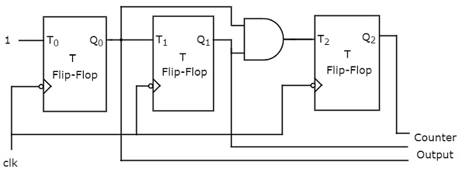
Synchronous Counter

Slide 33
Synchronous Counters
To eliminate the "ripple" effects, use a common clock for each flip-flop and a combinational circuit to generate the next state.
For an up-counter, use an incrementer =>
Incre-menter
A3
S3
D3
Q3
A2
S2
D2
Q2
A1
S1
D1
Q1
A0
S0
D0
Q0
Clock

Slide 34
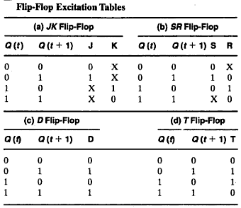
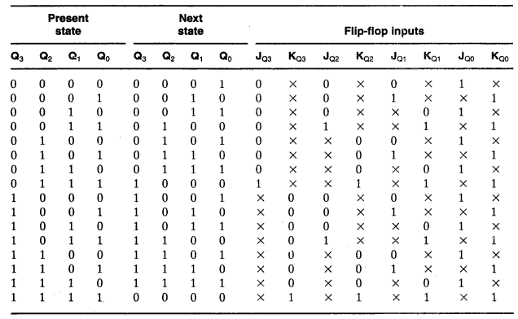
4-bit Synchronous Counter with J-K

Slide 35
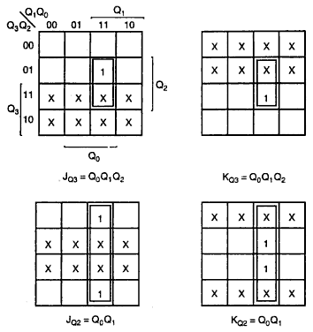
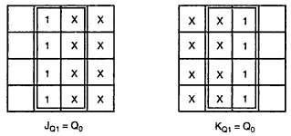
K-Maps

Slide 36
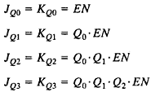
Equations
EN has been added to control the operation of the counter
This relations could be generalized
A Carry Output (CO) has been added so that the counter could be extended to more stages
The implementation might be positive/negative edge triggered

Slide 37
Arbitrary Counter
Design an arbitrary counter that repeatedly follows the following sequence:
0, 1, 2, 4, 5, 6, 0, 1, 2, 4, 5, 6, 0. . .

Slide 38
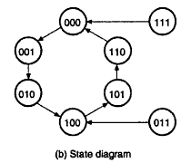
Arbitrary Counter

Slide 39
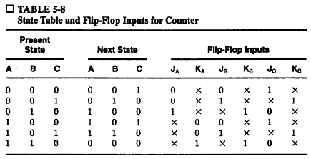

Arbitrary Counter: State Table

Slide 40
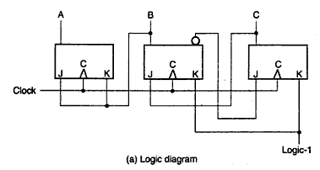
Arbitrary Counter: Logic Diagram

Slide 41
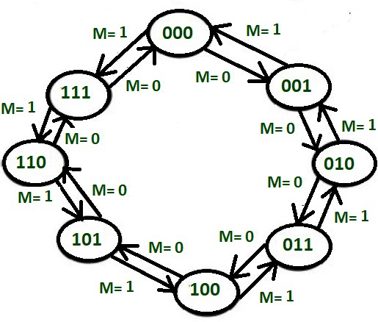
3 bit up down Synchronous Counter

Slide 42
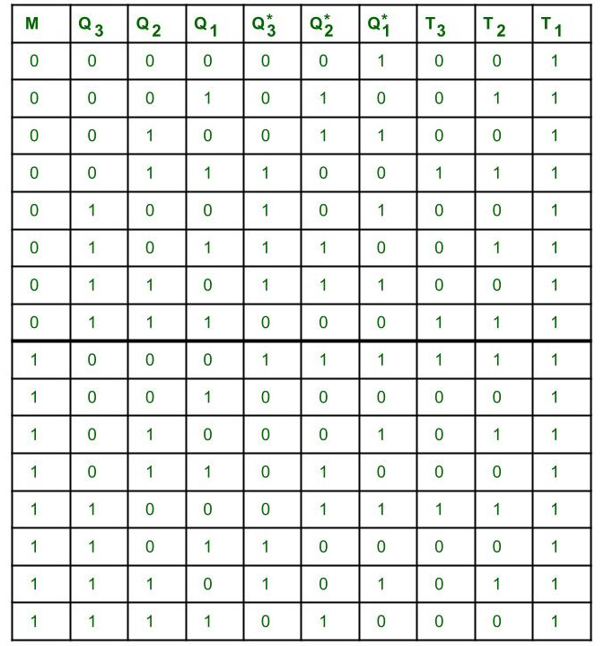

Slide 43
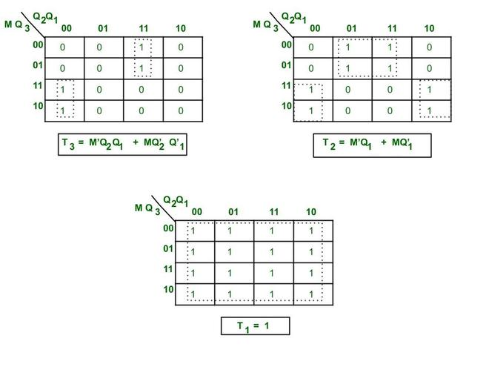
3 bit up down Synchronous Counter

Slide 44
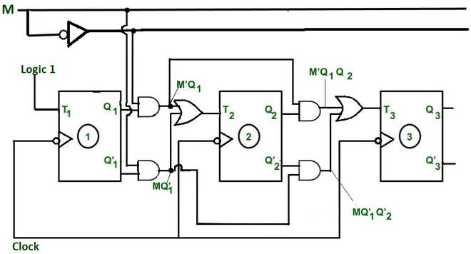
3 bit up down Synchronous Counter

Slide 45
Thank You

